Slide 1
Informing targeted public health measures with data-driven decision modeling W. Alton Russell, PhD Assistant Professor McGill School of Population and Global Health
Presented at the Dalla Lana School of Public Health, University of Toronto, 13 January 2023

Slide 3



About me

Slide 4
D³Mod: data-driven decision modeling lab
Decision analysis
Inform effective, equitable, efficient policy-making
Application areas
Opioid harms reduction
Blood donor management
Cancer screening & treatment
Pandemic surveillance
A safe blood supply
D³Mod
Data-driven methods
Machine learning
Bayesian stats
Mathematical modeling
Simulation
Optimization

Slide 5
Agenda
Targeting overdose prevention for prescription opioid patients
Tailoring policies to manage iron deficiency in blood donors
Research plans

Slide 6

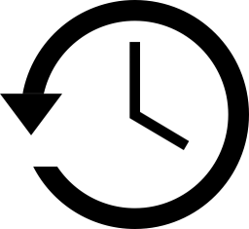
Blood donation and iron deficiency
Two safety measures in U.S.
But iron depletion for blood donors remains a problem
Minimum hemoglobin
Minimum inter-donation interval
12.5 g/dL for women
13.5 g/dL for men
56 days for single red cell unit
84 days for double red cells
5-10%
Donation attempts result in hemoglobin deferrals
20-40%
Completed donations come from donors with low or absent iron stores

Slide 7



Interventions for iron-related adverse outcomes
Intervention | Benefits | Drawbacks
Personalized IDI Tailor interval to donors’ estimated risk | Targets high-risk donors Balances risk vs. supply | Complex Untested
Intervention | Benefits | Drawbacks
Longer minimum IDI universal or sex-based | More time for iron recovery | Reduces donation frequency
Supplemental iron Dispense pills or vouchers | Hastens iron recovery No change to donation frequency | Cost Side effects (liability?)
Ferritin testing If low: longer IDI or supplemental iron | Targets the iron deficient Smaller threat to supply | No point-of-care test Cost Compliance

Slide 8
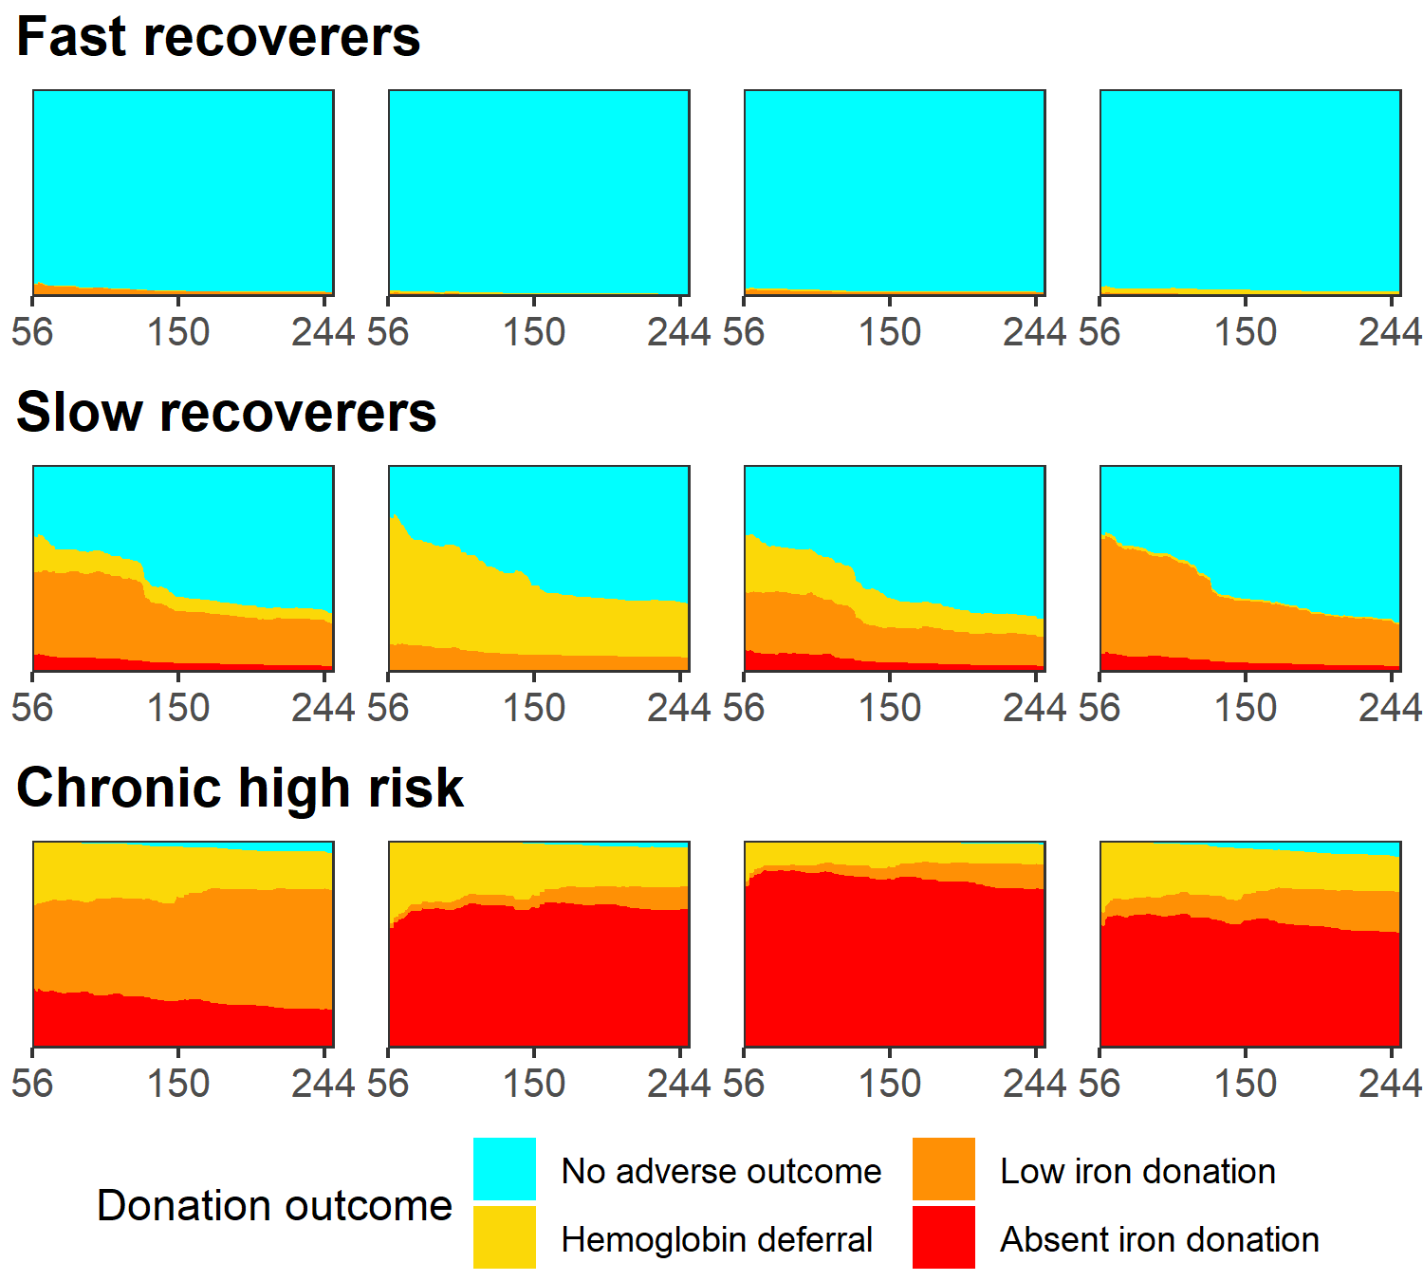
Prior work: Individual risk trajectories
Ensemble multiclass prediction model
US study of repeat donors 2007-2009 with ferritin measured at every visit
Ferritin, time to return, last hemoglobin, and donation history most important variables
Limitations:
Outdated & unrepresentative study population
Replication with recent operational data needed
Fig. 1 Individual risk trajectories for 12 donors. Estimated risk of adverse events (height of colored regions) based on the days until a return donation attempt (X-axis). Russell et. al., Transfusion 2021.

Slide 9
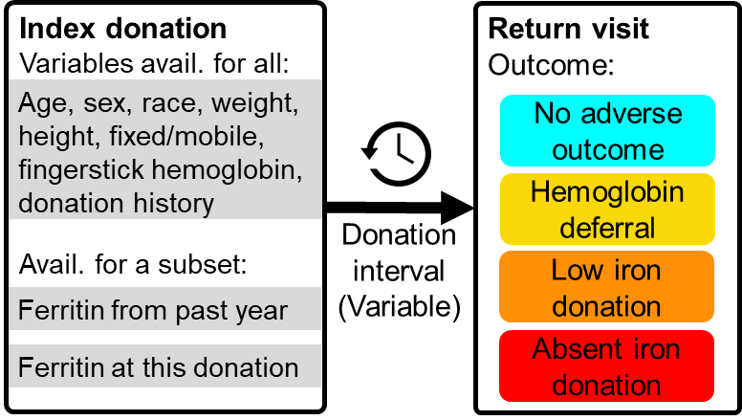
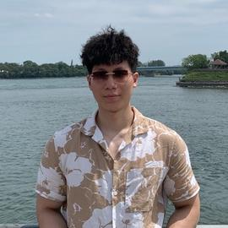
Aim 1: Risk prediction modeling
Develop and validate models to predict iron-related blood donor risk trajectories using operational data for multiple settings.
South Africa, United States, and the Netherlands
Chen-Yang Su, MSc
PhD student
Quantitative Life Sciences

Slide 10
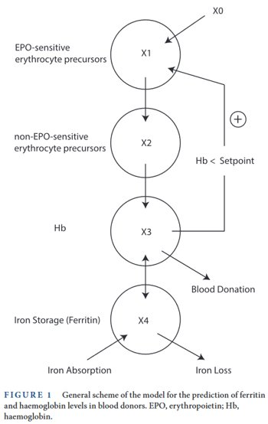
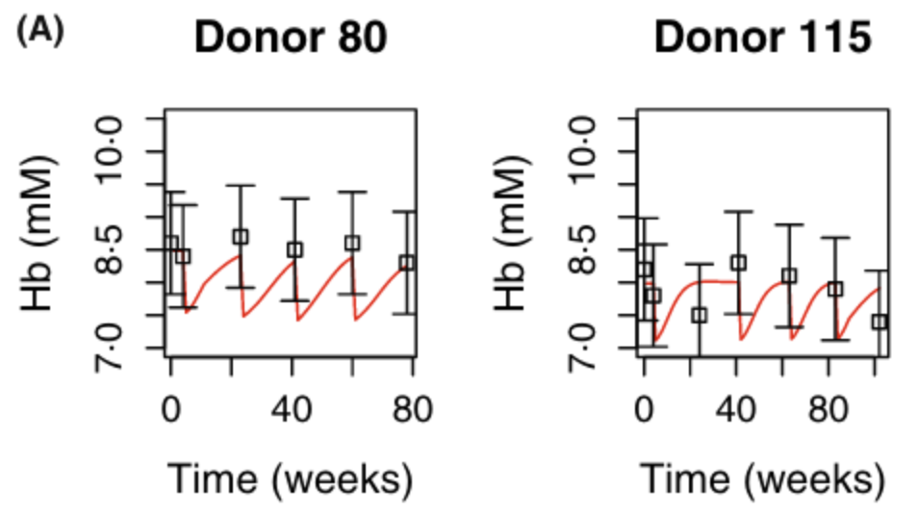
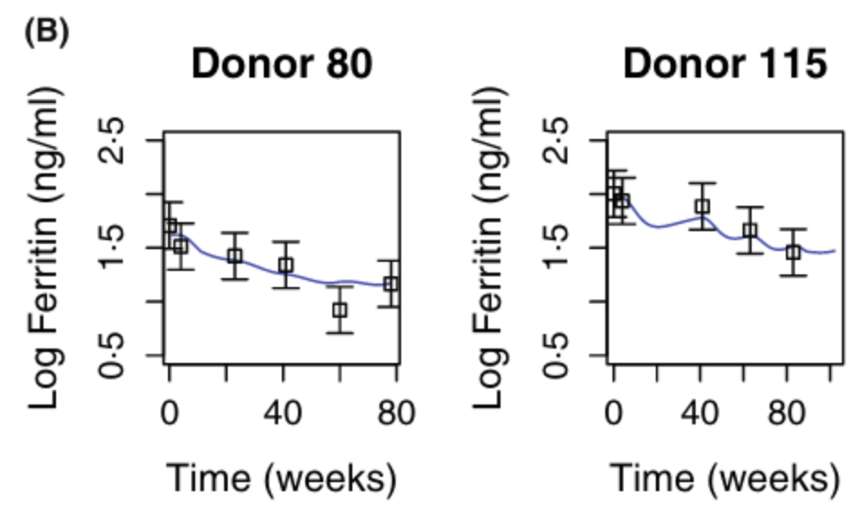
New approach: face-off between biologic systems model and machine learning
Comparing ODE model based on biological mechanism from Paalvast et. al. 2022
Developing on RISE dataset
Comparing generalizability to operational data from USA, South Africa, and the Netherlands
Palvaast et. al 2022 0.1111/bjh.18367

Slide 11
Agenda
Risk of iron deficiency in repeat blood donors
Predictive modeling
Policy simulation
Informing use of blood donors for public health surveillance
Using probabilistic survey data
Using administrative data

Slide 12
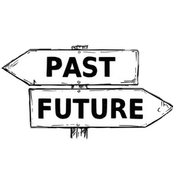



Blood donors: the backbone of COVID-19 serologic research & surveillance
By leveraging existing infrastructure, donor research can be more agile and less expensive than de novo studies of the healthy general population
Banked blood/plasma for retrospective research
When did COVID enter the population?
“Preregistered” healthy cohort, regular blood draws + questionnaire
Monitor population immunity
Understand serological dynamics
Notes:
In Canada and many countries, blood donors have become a backbone of SARS-CoV-2 research and surveillance. I cannot take any credit for this; in Canada these efforts have been led by our two blood collectors, Canadiian Blood Services and Hema-Quebec, along with the CITF here at McGill.

Slide 13
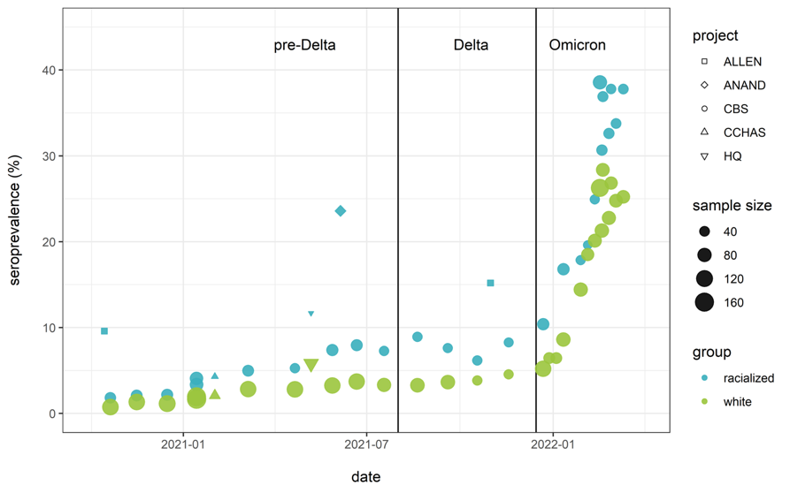
Most seroprevalence estimates in Canada come from Canadian Blood Services
Source: COVID-19 Immunity Task Force

Slide 14
Are blood donors representative in general?
Self-selection and eligibility criteria can erode generalizability
Healthy donor effect
Better self-rated health
Lower incidence of cancer
Less cardiovascular disease
Donors older, whiter, more financially secure
Atsma et. al. 2011, 10.1111/j.1537-2995.2010.03055.x; Van den Hurk et. al. 2017 10.1371/JOURNAL.PONE.0186662; Mark et. al. 1990 10.1093/ije/19.3.505; Shaz et. al. 2011 10.1016/S0027-9684(15)30316-3

Slide 15
Are blood donors representative with COVID-19?
Some initial evidence
Review of 33 donor-based seroprevalence studies found <1 in 5 adjusted estimates to the demographics of the general population, most that did focused on just sex and age
Similar seroprevalence found between blood donors and students/staff in the Vancouver public school system
Systematic analysis still needed
How are donors (not) representative?
How can we improve donor-derived COVID serology estimates?
Saeed et. al. 2020, 10.1111/vox.13221; Goldfard et. al. 2022, 10.1136/ bmjopen-2021-057846

Slide 16
Assessing population health utility of donor data
Could blood donor data augment probabilistically sampled surveys and contribute to health surveillance?
Convenience sample
Probabilistically sampled surveys
Blood donor data
Canadian Health Measures Survey
Canadian Longitudinal Study on Aging
COVID-19 seroprevalence studies
Aim: Assess utility of donor data and methods to adjust for bias
Areas: SARS-CoV-2, iron status, general health indicators

Slide 17
Data for COVID-19 aim
Donor studies
Canadian Blood Services
Héma-Québec
Probabilistically sampled
CCAHS, CLSA, others
Organize individual-response data from each study by age group, sex, socio-demographic factors, and province or territory, and sample data
Add area-level covariates that might predict donation and/or COVID-19 risk
median household income, proportion completing high school, measures of deprivation, proportion of immigrants, etc.

Slide 18
Method:
Filter donor data to match probabilistic survey sampling frame and time period
Comparisons:
Distribution of covariates Who’s (under)represented?
Raw seroprevalence estimates How different are measures?
Statistically adjusted seroprevalence estimates Can we correct them?

Slide 19
Multilevel regression + poststratification
Two steps
Fit Bayesian hierarchical regression model to sample
Use population size in each poststratification cell to weigh estimates
Advantage
Can consider more strata then e.g. raking
Estimate for each cell partially pooled toward mean, larger effect in smaller cells
Requires:
Good knowledge about populations sizes in each stratum
Samples within post-stratification cells are representative

Slide 20
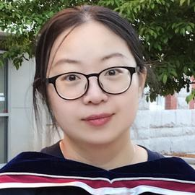
Next steps
Limitations
Assay differences (incorporate measurement model?)
Are probabilistic surveys really a goal standard?
Dr. Yuan Yu starting as a postdoc October 1!
Yuan Yu, PhD
Postdoc in Bayesian multi-level modeling

Slide 21
Agenda
Risk of iron deficiency in repeat blood donors
Predictive modeling
Policy simulation
Informing use of blood donors for public health surveillance
Using probabilistic survey data
Using administrative data

Slide 22
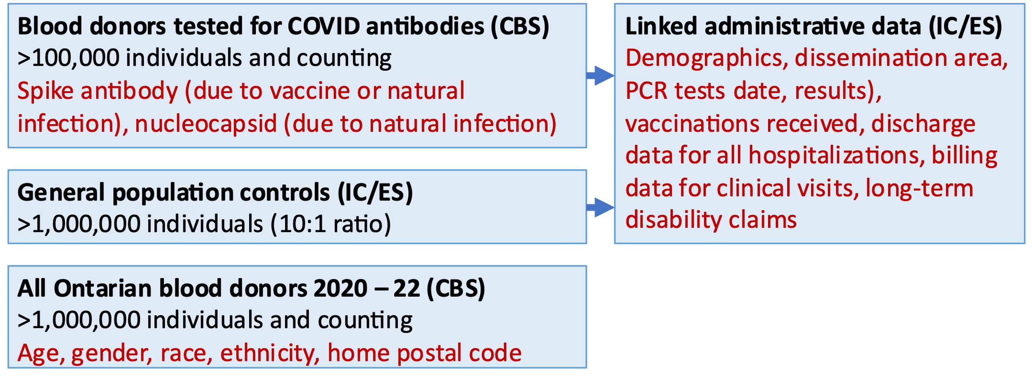
Linked donor-admin data + controls

Slide 23
Overview of proposed projects
Assess bias and representativeness of blood donor data
Compare demographics and COVID-19-related outcomes between blood donors and general population controls
Develop corrective strategies
Statistical adjustment, targeted sampling of blood donors, and synthesizing supplemental data from other sources.
Estimate impact of corrective strategies
Create a simulation model to estimate the assess corrective strategies

Slide 24
Aim 1: Assess bias and representativeness of blood donor data
Assess representativeness
Compare COVID-19 outcomes
Data available to define strata | COVID-19 related outcomes
Age, sex, geography (forward sortation area), urban/rural, non-covid healthcare utilization (hospitalizations, doctors’ visits), long-term disabilities, neighborhood-level indices of deprivation. | (1) PCR testing rate (2) PCR test positivity rate, (3) COVID hospitalization incidence (4) COVID-19 vaccination level (0, 1, 2, or 3+ dose)
Idea: could also similarly compare probabilistic surveys to admin data

Slide 25
Aim 2: Develop corrective strategies
Statistical adjustment: Multilevel regression with poststratification
Targeted sampling: sample donors from underrepresented strata more frequently
Supplemental data synthesis: sample non-donors and synthesis

Slide 26
Aim 3: Estimate impact of corrective strategies
Retrospectively simulate generating estimate each month based on prior data
Estimate confidence intervals with bootstrapping
Statistical adjustment
Compare (1) directly calculating seroprevalence, (2) estimating seroprevalence using a Bayesian multilevel model, and (3) applying post-stratification to the modeled estimate.
Also develop Bayesian model with and without covariates from linked admin data
Targeted sampling
Simulate random & targeted donor sampling. Assign antibody positivity to sampled donors based on a probability estimated using our Bayesian multilevel model
Supplemental sampling
Simulate sampling non-donor controls and observing their seropositivity each month. Make assumptions about differences in seropositivity between donors and non-donors informed by Aim 1

Slide 27
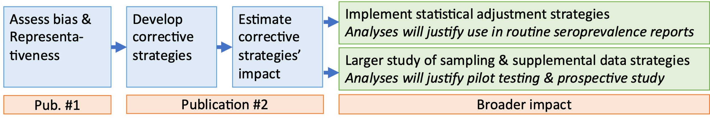
Outcomes + broader impact

Slide 28
Appendix slides

Slide 29
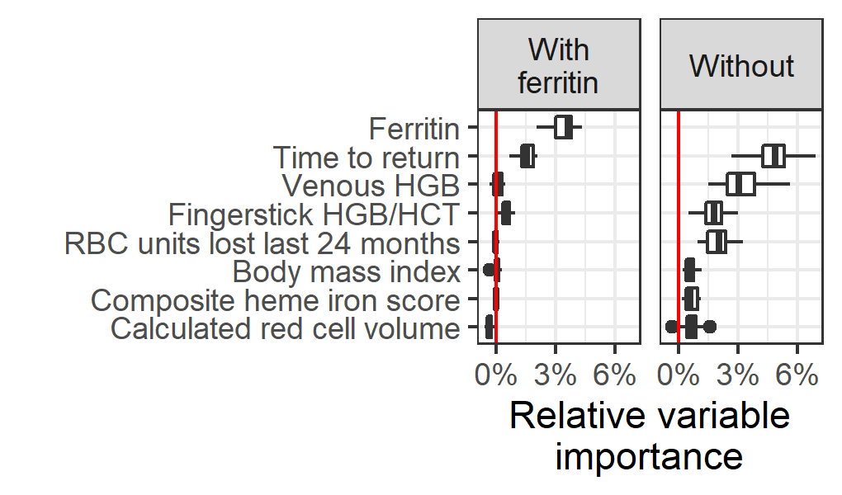
Variable importance
Most important variables for top ensemble models, with and without ferritin as a predictor. Russell et. al., Transfusion 2021

